Slide 1
Revolutionizing The Typing Test
PorkType
December 2025
Gael Carrillo
Jason Escalante
Armando Vargas
Property of PorkType llc

Slide 2




What We Used
Our mission
Property of PorkType llc
r

Slide 3

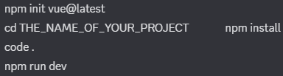
Environment Setup
Framework - Vue with Routing , installed on VsCode
Persistent storage - MongoDB
Make sure you have git and node installed
Running on Localhost
Version control - git and github
Virtual meetings for progress and updates
Fingerprint API had to install so it works on everyone's device
Property of PorkType llc

Slide 4
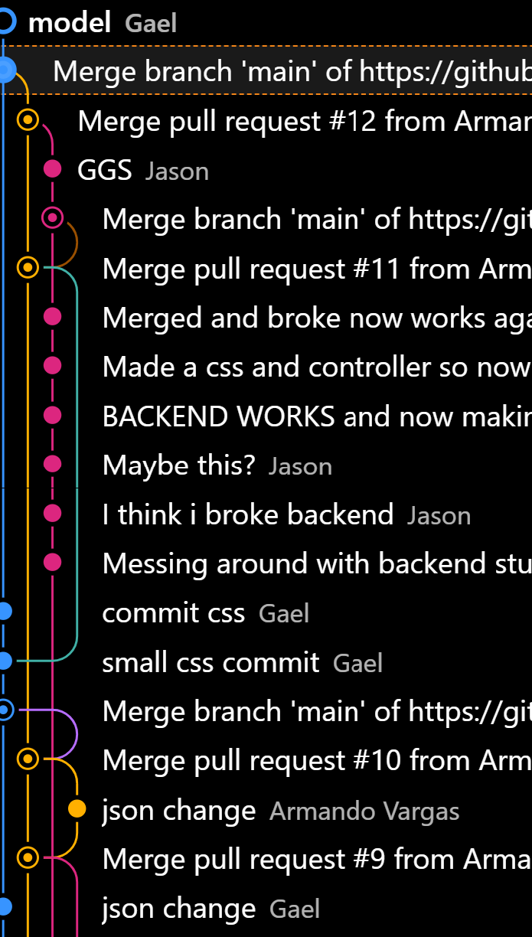
Issues
Github
Third Party API’s
Meeting Requirements
Merging Conflicts
Commits
Switching API’s part way through
Being able to read documentation
Got rid of a whole API on our project
Carried away
Feature Creep
Modeling
Property of PorkType llc

Slide 5
Success for us
We have succeeded when our typing game displays you result at the end
we are able to see the WPM.
Persistent data.
Logins
Sign ups
Property of PorkType llc

Slide 6
Preparation Phase
User Stories: A typical user would be any student in a University, high school, elementary or middle school, who wants to get faster at typing or is taking a course to learn how to type. Even working adults who want to type on an expert level.
Features/Requirements:
  Has to be able to measure WPM and have at least a 30 sec timer
  Once timer ends the typing result is displayed
  It marks what you get wrong
  Text in the typing game is randomly generated
  Play music depending on the speed
  Measure Accuracy
Property of PorkType llc

Slide 7
The Documentation
1
Sheets
2
DOCS
Property of PorkType llc

